Slide 1
NHS Diagnostic Analysis
Youko Fujino

Slide 2
Agenda
Background & Scenario
Insights
What is the actual utilisation of resources?
Has there been adequate staff and capacity in the networks?
What are the main reasons for missed appointments?
What is the public opinion on NHS on capacity? Twitter-based analysis
Conclusion & Recommendations

Slide 3
Business Scenario
NHS capacity is debated among stakeholders. Investigate reasons for missed appointments as they lead to significant costs for the NHS. Key questions:

Slide 4
Pattern & Insights
What is the actual utilisation of resources?
Has there been adequate staff and capacity in the networks?
What are the main reasons for missed appointments?
What is the public opinion on NHS on capacity? Twitter-based analysis

Slide 5
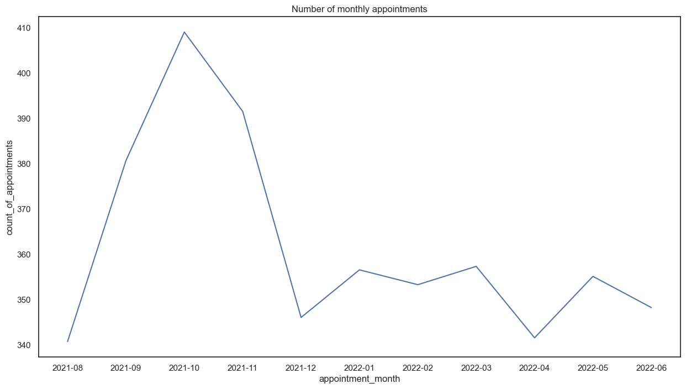
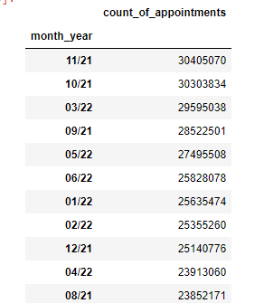
NHS appointments peaked in 2021 (covid), but there is an overall fall in appointments during Holiday periods
NHS Usage Seasonality
Oct,Nov_2021 and Mar_2022 registered the peak of appointments. As a context, it coincides with the Omicron Surge (Late_21- Early_22) but also with pre-holidays periods.
COVID

Slide 6
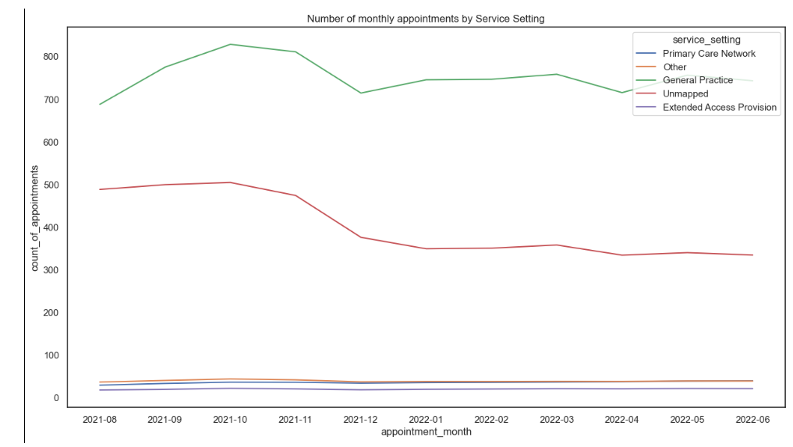
GP is the predominant service, reflecting the overall curve of NHS appointments
NHS Services
NHS PEAKS
Oct,Nov_2021 and Mar_2022 registered the peak of appointments. As a context, it coincides with the Omicron Surge (Late_21- Early_22) but also with pre-holidays periods

Slide 7
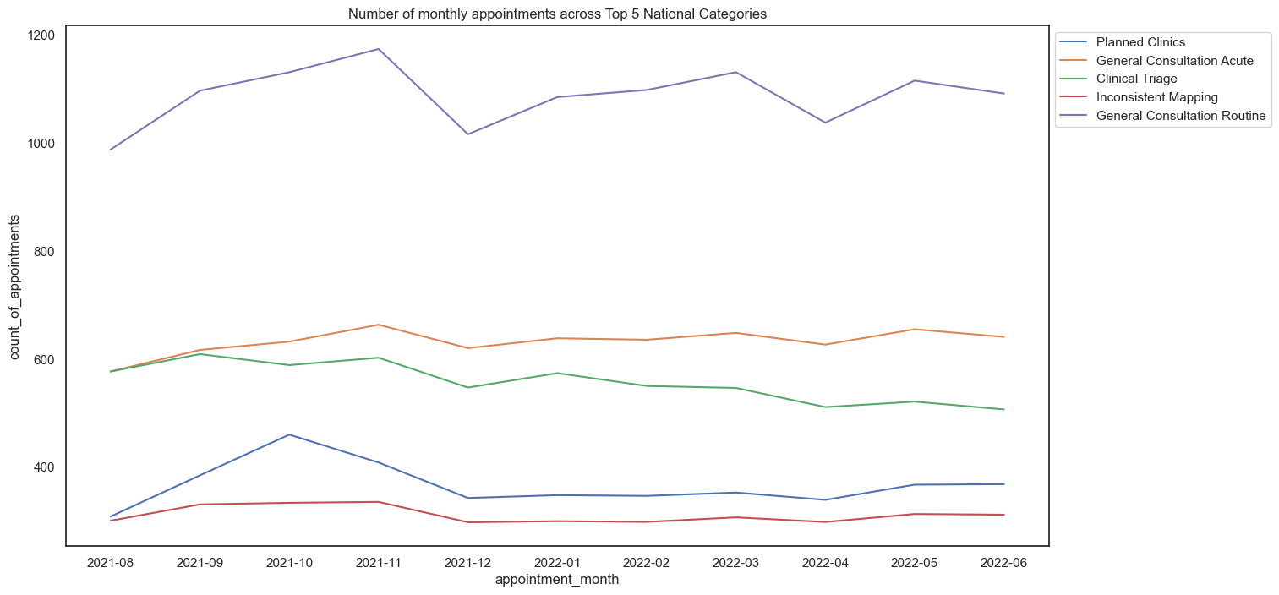


General Consultation Routines and Acute are the top two categories, followed by triages. However, all them fall during holiday periods (Christmas and Easter)
National Categories
NHS PEAKS
NHS PEAKS
Oct,Nov_2021 and Mar_2022 registered the peak of appointments. As a context, it coincides with the Omicron Surge (Late_21- Early_22) but also with pre-holidays periods

Slide 8
General Consultation Routines and Acute are the top two categories, followed by triages. However, all them fall during holiday periods (Christmas and Easter)
National Categories
NHS PEAKS
NHS PEAKS
Oct,Nov_2021 and Mar_2022 registered the peak of appointments. As a context, it coincides with the Omicron Surge (Late_21- Early_22) but also with pre-holidays periods

Slide 9
Pattern & Insights
What is the actual utilisation of resources?
Has there been adequate staff and capacity in the networks?
What are the main reasons for missed appointments?
What is the public opinion on NHS on capacity? Twitter-based analysis

Slide 10
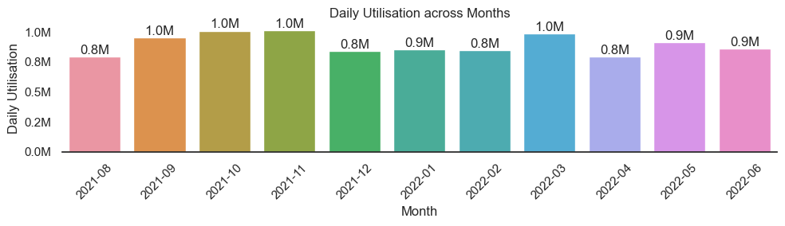
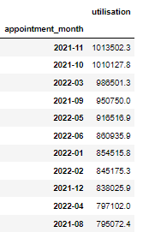
All months are within the NHS's capacity: 1.2M
NHS Capacity and Daily Appointments
The NHS has provided an average of 1.2M daily appointments as a guideline for maximum capacity
All months are within the NHS's capacity: 1.2M .
Recommendation: Rotate staff so that peak months (Sep, Oct, Nov) have a more extensive staff, while less busy months (December) have a smaller staff.

Slide 11
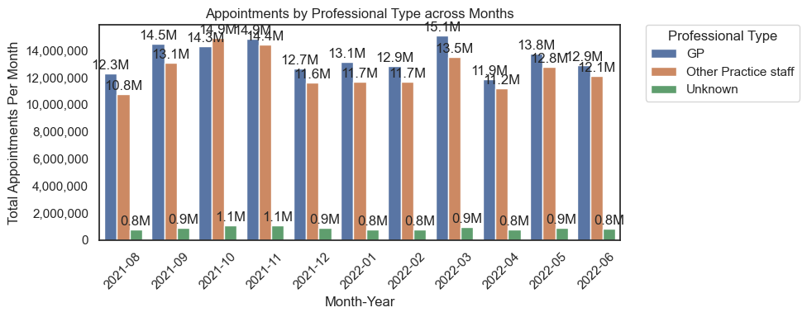
GPs are the most demanded professionals, but in 2021, other specialist were more demanded probably due to covid
Which Health Care Professional is most demanded by NHS?
Recommendation: prioritise GP professionals in peak moments and for HR recruiting.

Slide 12
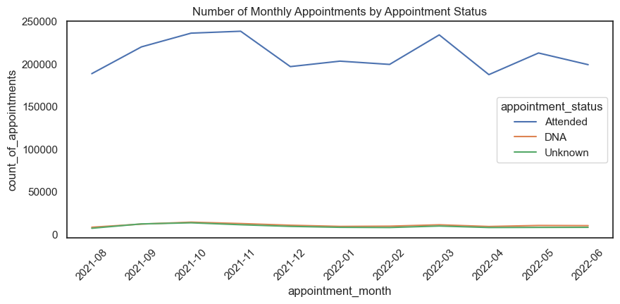
Attended appointments fall in festive periods (Xmas and Easter)
Are there significant changes in whether visits are attended?
Recommendation: Prioritise phone/online appointments in these periods as people are generally on holiday. Also, might be useful to limit the bookings in festive periods for non-urgent issues.

Slide 13
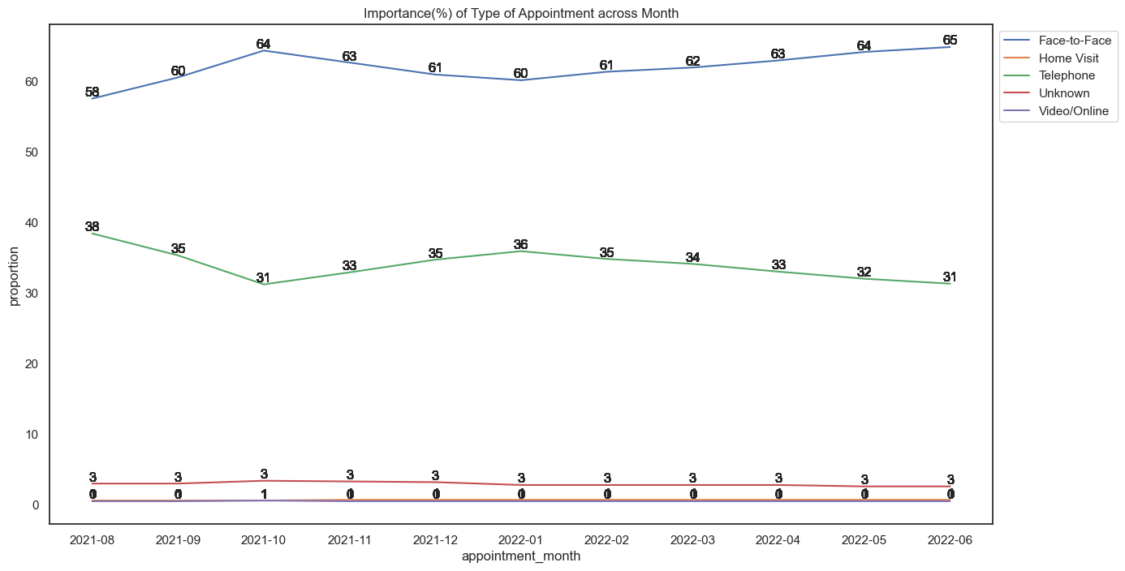
Face-to-face appointments fall in holiday periods in detriment to phone appointments
Are there changes in terms of appointment type and the busiest months?
More than 60% of appointments are face-to-face.
In the busiest months (Oct,Nov, Mar) there is an uplift of face-to-face in detriment of phone-based, which gain importance during holiday periods (Nov, Dec, Jan).
Recommendation: Prioritise phone/online appointments in festives periods as people are often outside their hometowns. Also, it is helpful to limit the bookings in festive periods for non-urgent issues.

Slide 14
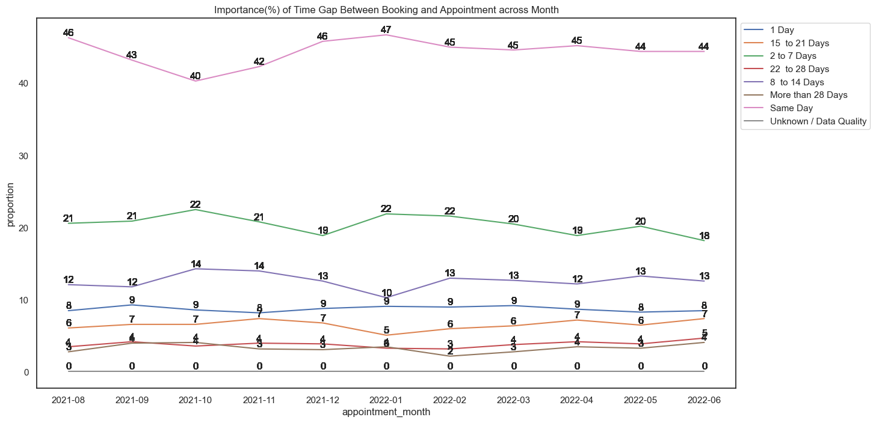
Face-to-face appointments fall in holiday periods in detriment to phone appointments
Are there any trends in time between booking an appointment?¶
Most appointments are scheduled for the same day, with a gain of imp(%) in Dec/Jan. The same happens for 2-7 days.
Hypothesis: there is more urgency during holiday periods:
1. + people abroad, 2. + accidents are more likely to occur during the festive season.

Slide 15
Pattern & Insights
What is the actual utilisation of resources?
Has there been adequate staff and capacity in the networks?
What are the main reasons for missed appointments?
What is the public opinion on NHS on capacity? Twitter-based analysis

Slide 16
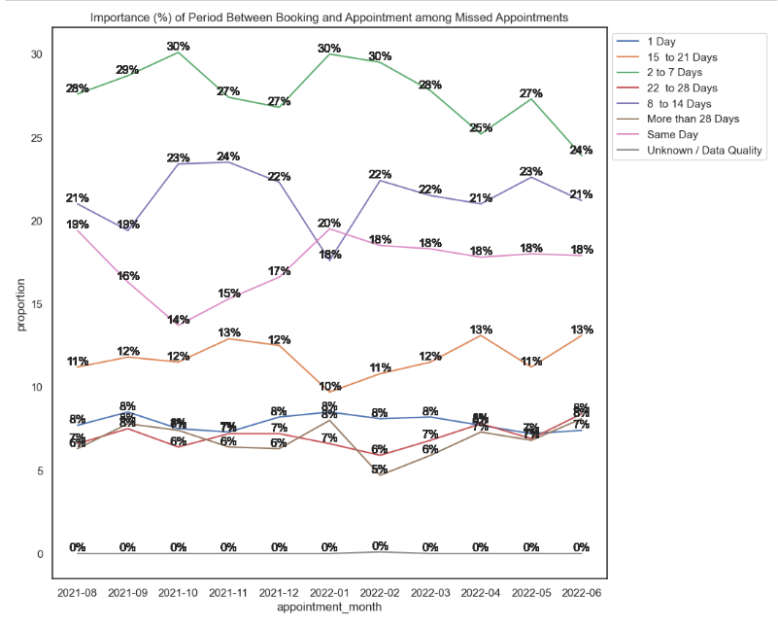
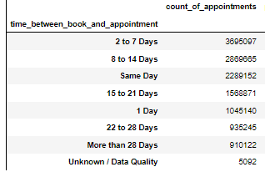
Same days appointments show a decline in missed appointments over time, probably because same day appointments tend to be more urgent.
What are the main reasons for missed appointments?
Number of Missed Appointments by
Time Between Booking and Appointment
Same-day appointments show lower importance among Missed Appointment vs Attended Appointments
Recommendation: Limit Max Booking time to 7 days in advance

Slide 17
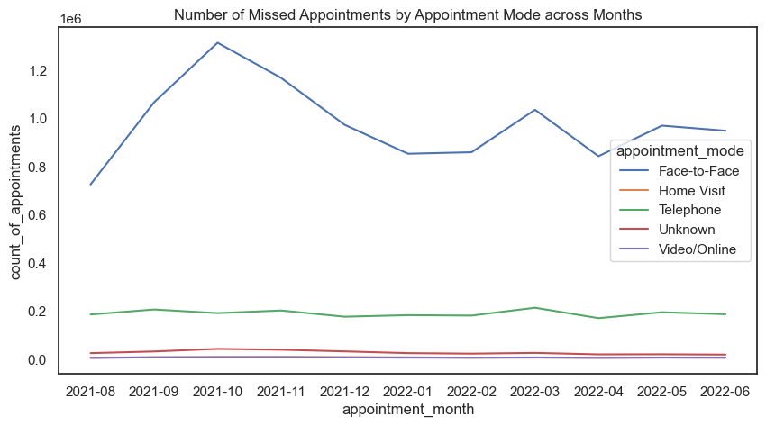
Missed appointments are mostly face-to-face or by phone, but with a steep decline of face-to-face with the festive seasons approaching
What are the main reasons for missed appointments?
Recommendation: Limit Face-to-face appointments in Pre-Xmas and Pre-Easter periods

Slide 18
Pattern & Insights
What is the actual utilisation of resources?
Has there been adequate staff and capacity in the networks?
What are the main reasons for missed appointments?
What is the public opinion on NHS on capacity? Twitter-based analysis

Slide 19
Words associated with staff capacity (capacity, busy, saturate) DON’T appear in the Top Retweeted/Favorited Hashtags, Top Tweets text and in the World Clouds. Of the 1173 tweets analysed, only 2 mention capacity-related words, and only 1 is relevant to the NHS capacity problem. However, there are mentions of words such as employment and job that might indicate a buzz towards the NHS capacity issue.

Slide 20
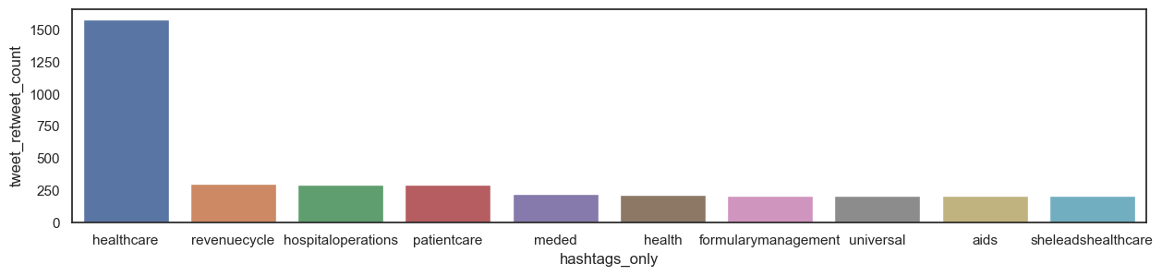
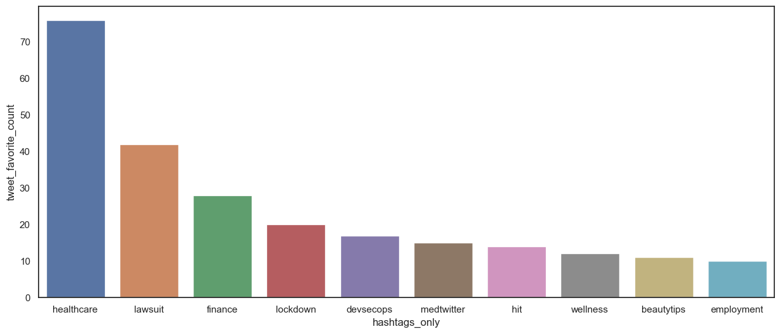
No Mentions on NHS Capacity among Top Hashtags
What are the Top 10 hashtags?
Top 10 Retweeted hashtags
Top 10 Favourited hashtags

Slide 21
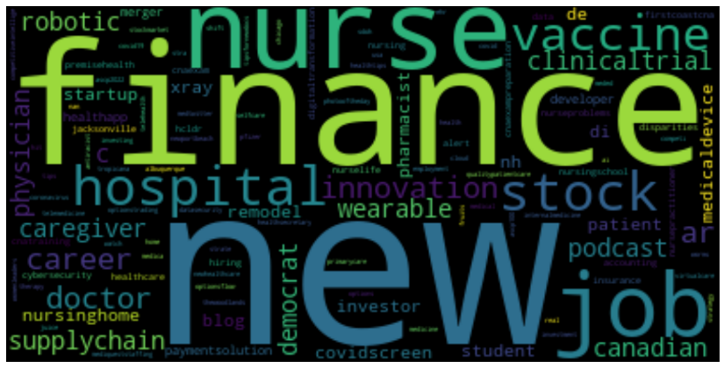
World Cloud: NHS Hashtags

Slide 22
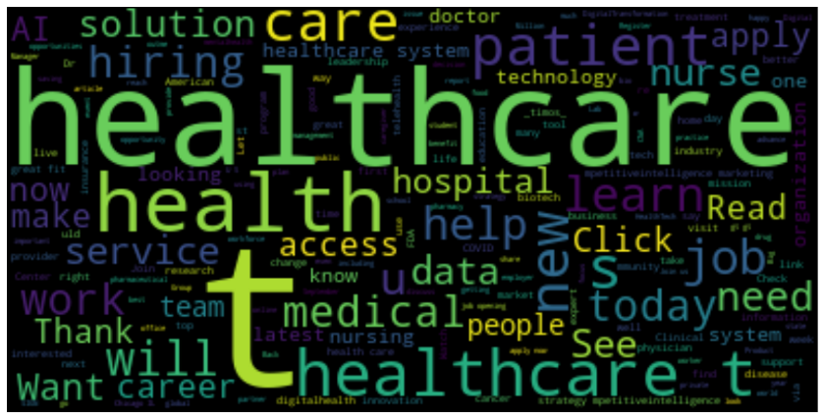
World Cloud: NHS Tweets Texts

Slide 23
Conclusions
NHS Usage and Seasonality | NHS Capacity | NHS Missed Appointments | NHS Public Opnion (Twitter Based)
GP is the predominant service, with peaks of Other Specialist during covid period | The NHS has 1.2M daily appointments as a guideline for maximum capacity. | Attended appointments fall in festive periods (Xmas and Easter) | Words associated with staff capacity (capacity, busy, saturate) DON’T appear in the Top Retweeted/Favorited Hashtags, Top Tweets text, and the World Clouds. Of the 1173 tweets analysed, only 2 mention capacity-related words, and only 1 is relevant to the NHS capacity problem. However, there are mentions of words such as employment and job that might indicate a buzz towards the NHS capacity issue
Oct,Nov_2021 and Mar_2022: peak of appointments: Omicron Surge (Late_21- Early_22) and pre-holidays periods | All months are within the NHS's capacity | Same days appointments show a decline among missed appointments, probably because same day appointments tend to be more urgent.
Most appointments are short-noticed, with an increase of short-noticed appointments in Dec/Jan |  | Missed appointments are mostly face-to-face or by phone
General Consultation Routines and Acute are the top two categories, followed by triages. However, all them fall during holiday periods (Christmas and Easter)

Slide 24
Recommendations
+ STAFF IN PEAK PERIODS
+ GP PROFESSIONALS
LIMIT BOOKINGS IN PRE-FESTIVE SEASONS
Rotate staff so that peak months (Sep, Oct, Nov) have a more extensive staff, while less busy months (Xmas, Easter) can have a smaller staff.
Prioritise GP professionals in peak periods and for HR recruiting.
-Diminish the overall booking availability for non-urgent cases in festive periods
-Prioritise phone/online appointments as people are often outside their hometowns
*Oct,Nov_2021 and Mar_2022 registered the peak of appointments. As a context, it coincides with the Omicron Surge (Late_21- Early_22) but also with pre-holidays periods

Slide 25
Thank you

